Slide 1
Introduction to Discrete Choice Experiments
Anna Heath – Petros Pechlivanoglou
The Hospital for Sick Children
University of Toronto
Including joint work with DARTH workgroup

Slide 2
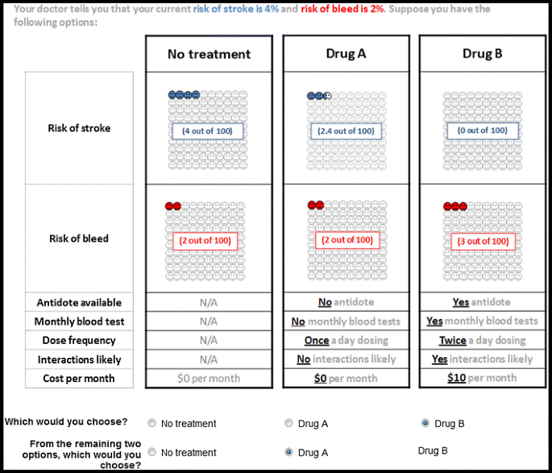
Discrete Choice Experiments
Discrete choice experiments are a stated preference method where subjects must choose between two or more options that are defined through a set of attributes.
Each attribute can take values from a pre-defined set of levels.
Notes:
Three main approaches
Specialized decision modeling software
TreeAge, Data, Crystal8, Arena etc.
Spreadsheet software
Microsoft Excel, Open/Libre Office
Statistical/ Computer programing software
Matlab, R, C++, Python, WinBUGS, etc

Slide 3
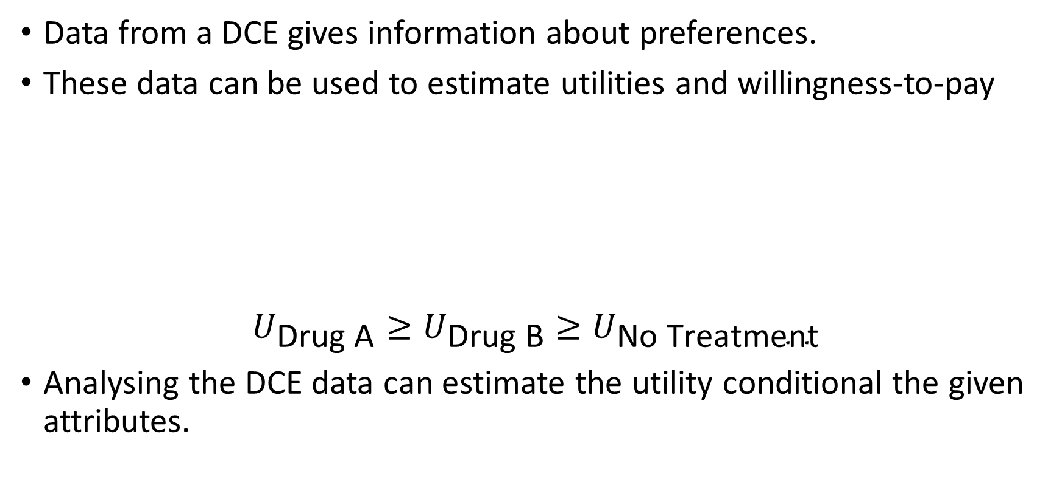
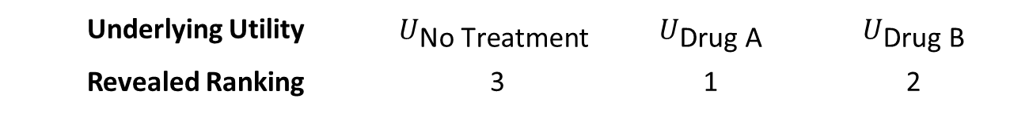
Discrete Choice Experiments
Data from a DCE gives information about preferences.
These data can be used to estimate utilities and willingness-to-pay
$$U_{\text{Drug} \text{A}}≥U_{\text{Dru}\text{g} \text{B}}≥U_{\text{No} \text{Treatment}}$$
Analysing the DCE data can estimate the utility conditional the given attributes.
Underlying Utility | $$U_{\text{No} \text{Treatment}}$$ | $U_{\text{Drug} \text{A}}$ | $$U_{\text{Drug} \text{B}}$$
Revealed Ranking | 3 | 1 | 2
Notes:
Three main approaches
Specialized decision modeling software
TreeAge, Data, Crystal8, Arena etc.
Spreadsheet software
Microsoft Excel, Open/Libre Office
Statistical/ Computer programing software
Matlab, R, C++, Python, WinBUGS, etc

Slide 4
Designing a Discrete Choice Experiment
Define research question
DCE design is a complex process, requiring both qualitative and quantitative skills.
Literature Reviews
Expert Consultation
Public Consultations
Pilot Study(ies)
Efficient Designs
Determine attributes
Select attribute levels
Experimental design
Data collection
Citations
Weber, S. (2019). A Step-by-Step Procedure to Implement Discrete Choice Experiments in Qualtrics.
Coast J, Horrocks S. (2007) Developing attributes and levels for discrete choice experiments using qualitative methods.
Johnson FR, Lancsar E, Marshall D, Kilambi V, Muhlbacher A, Regier DA, et al. (2013) Constructing experimental designs for discrete choice experiments: report of the ISPOR conjoint analysis experimental design good research practices task force.
Statistical analysis

Slide 5

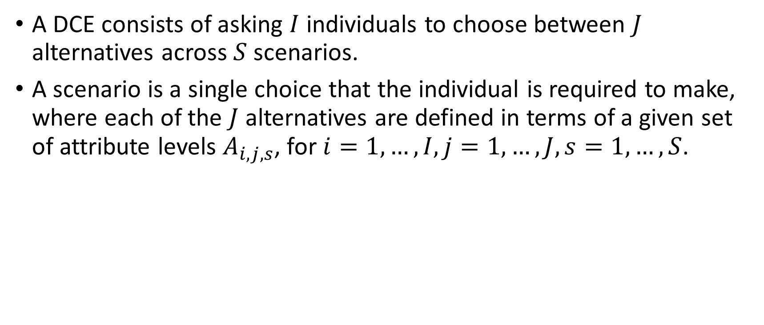
Discrete Choice Experiments
A DCE consists of asking $I$ individuals to choose between $J$ alternatives across $S$ scenarios.
A scenario is a single choice that the individual is required to make, where each of the $J$ alternatives are defined in terms of a given set of attribute levels $A_{i,j,s}$, for $i=1,…,I, j=1,…, J, s=1, …, S$.
Attribute 1
Alternative A
Attribute 2
Attribute 3
Attribute 4
Attribute 5
Levels
Attribute 1
Alternative B
Attribute 2
Attribute 3
Attribute 4
Attribute 5
Notes:
Three main approaches
Specialized decision modeling software
TreeAge, Data, Crystal8, Arena etc.
Spreadsheet software
Microsoft Excel, Open/Libre Office
Statistical/ Computer programing software
Matlab, R, C++, Python, WinBUGS, etc

Slide 6
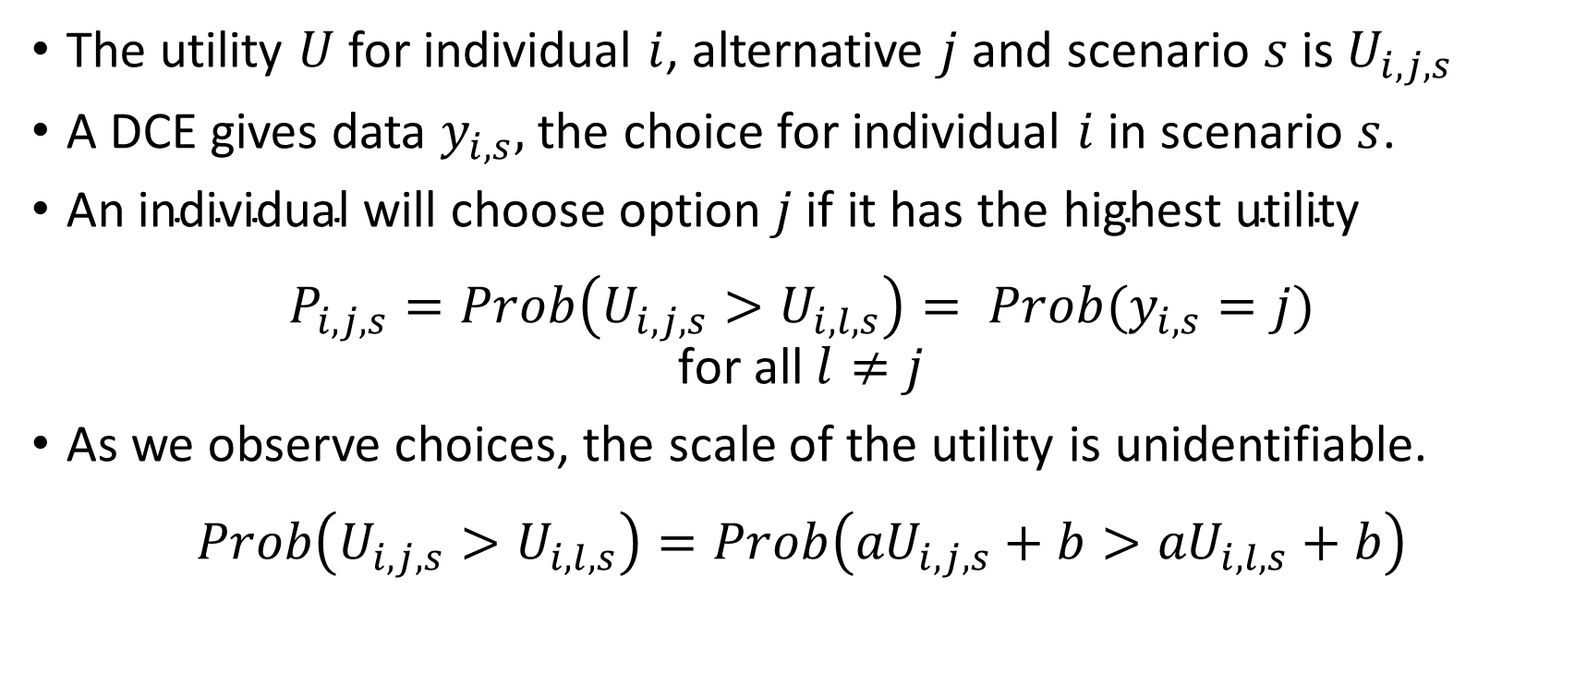
Estimating Utilities
The utility $U$ for individual $i$, alternative $j$ and scenario $s$ is$U_{i,j,s}$
A DCE gives data $y_{i,s},$ the choice for individual $i$ in scenario $s$.
$\text{An} \text{individual} \text{will} \text{choose} \text{option} j \text{if} \text{it} \text{has} \text{the} \text{highest} \text{utility}$
$$P_{i,j,s}=Prob\left(U_{i,j,s}>U_{i,l,s}\right)= Prob(y_{i,s}=j)$$
$$\text{for} \text{all} l≠j$$
As we observe choices, the scale of the utility is unidentifiable.
$$Prob\left(U_{i,j,s}>U_{i,l,s}\right)=Prob\left({aU}_{i,j,s}+b>{aU}_{i,l,s}+b\right)$$
Notes:
Three main approaches
Specialized decision modeling software
TreeAge, Data, Crystal8, Arena etc.
Spreadsheet software
Microsoft Excel, Open/Libre Office
Statistical/ Computer programing software
Matlab, R, C++, Python, WinBUGS, etc

Slide 7
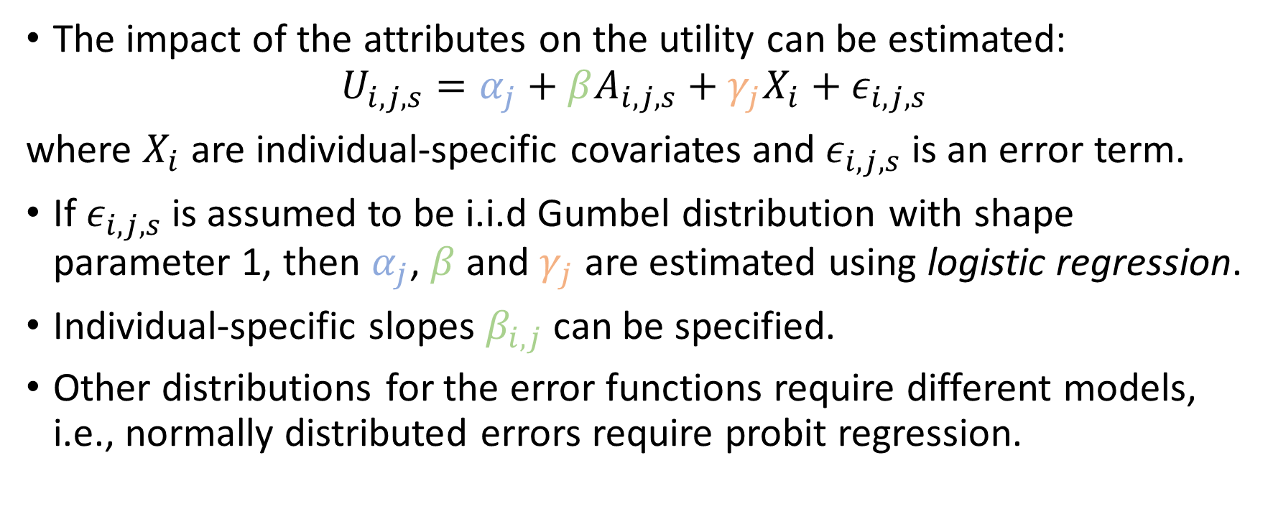
Multinomial Logistic Regression
The impact of the attributes on the utility can be estimated:
$$U_{i,j,s}=α_{j}+βA_{i,j,s}+γ_{j}X_{i}+ε_{i,j,s}$$
where $X_{i}$ are individual-specific covariates and $ε_{i,j,s}$ is an error term.
If $ε_{i,j,s}$ is assumed to be i.i.d Gumbel distribution with shape parameter 1, then $α_{j}$, $β$and $γ_{j}$ are estimated using logistic regression.
Individual-specific slopes $β_{i,j}$ can be specified.
Other distributions for the error functions require different models, i.e., normally distributed errors require probit regression.
Notes:
Three main approaches
Specialized decision modeling software
TreeAge, Data, Crystal8, Arena etc.
Spreadsheet software
Microsoft Excel, Open/Libre Office
Statistical/ Computer programing software
Matlab, R, C++, Python, WinBUGS, etc

Slide 8
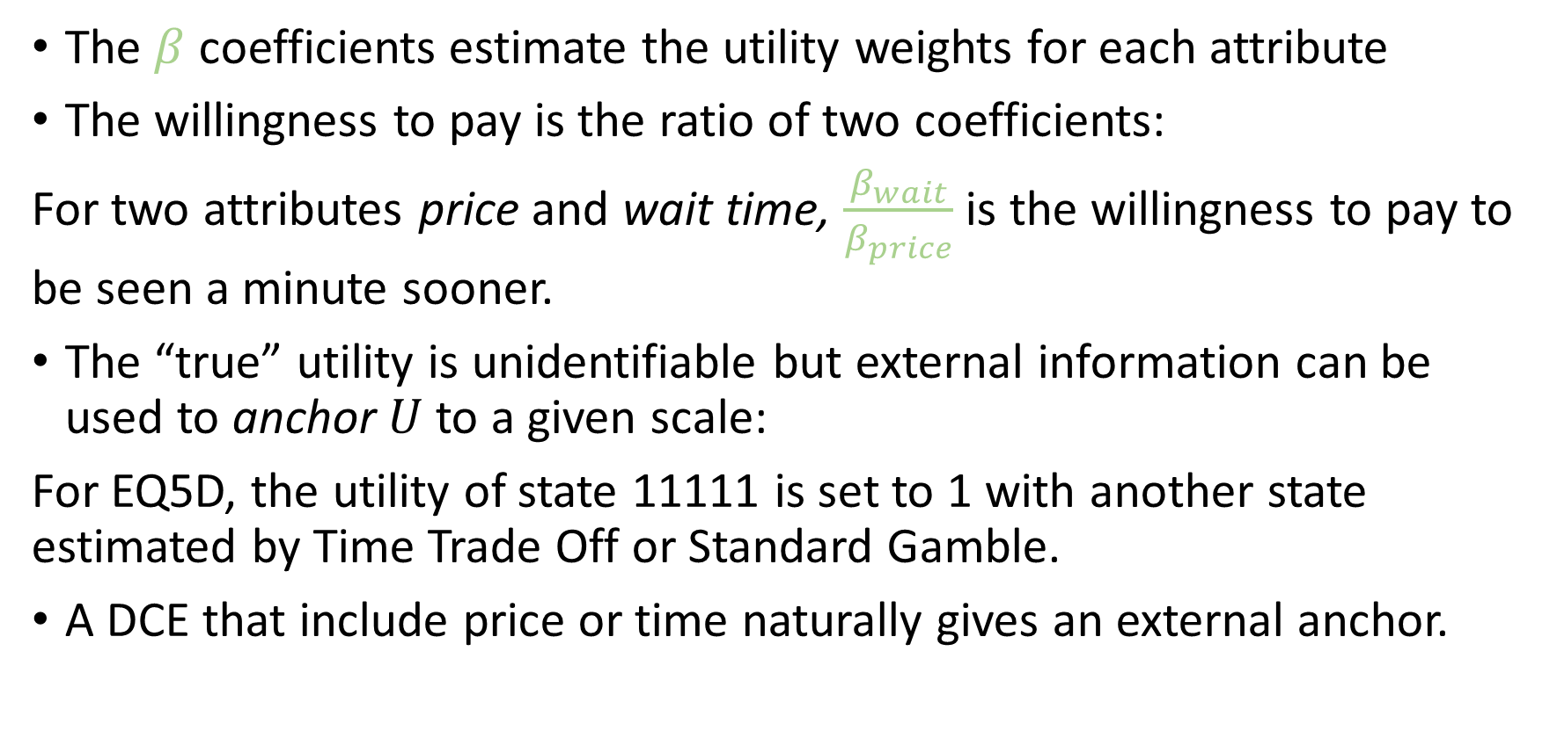
Interpreting the Results
The $β$ coefficients estimate the utility weights for each attribute
The willingness to pay is the ratio of two coefficients:
For two attributes price and wait time, $\frac{β_{wait}}{β_{price}}$ is the willingness to pay to be seen a minute sooner.
The “true” utility is unidentifiable but external information can be used to anchor $U$ to a given scale:
For EQ5D, the utility of state 11111 is set to 1 with another state estimated by Time Trade Off or Standard Gamble.
A DCE that include price or time naturally gives an external anchor.
Notes:
Three main approaches
Specialized decision modeling software
TreeAge, Data, Crystal8, Arena etc.
Spreadsheet software
Microsoft Excel, Open/Libre Office
Statistical/ Computer programing software
Matlab, R, C++, Python, WinBUGS, etc

Slide 9
Data: Wide Form
ID | Choice | Attributes of A |  |  |  |  | Attributes of B
1 | A
1 | B
1 | A
2 | A
⁞ | ⁞ | ⁞ |  |  |  |  | ⁞
Notes:
Three main approaches
Specialized decision modeling software
TreeAge, Data, Crystal8, Arena etc.
Spreadsheet software
Microsoft Excel, Open/Libre Office
Statistical/ Computer programing software
Matlab, R, C++, Python, WinBUGS, etc

Slide 10
Data: Long Form
ID | Choice | Alternative | Attributes
1 | TRUE | A
1 | FALSE | B
1 | FALSE | A
1 | TRUE | B
1 | TRUE | A
1 | FALSE | B
2 | TRUE | A
2 | FALSE | B
⁞ | ⁞ | ⁞ | ⁞
Notes:
Three main approaches
Specialized decision modeling software
TreeAge, Data, Crystal8, Arena etc.
Spreadsheet software
Microsoft Excel, Open/Libre Office
Statistical/ Computer programing software
Matlab, R, C++, Python, WinBUGS, etc

Slide 11
Discrete Choice Experiment in R
There are several packages to analyse DCEs in R.
We will use the mlogit package which requires long form data
The apollo package is more flexible but has its own data storage method - http://www.apollochoicemodelling.com/
The Rchoice package is another alternative.
Packages for generalised linear models are also suitable, e.g., glm, glmmTMB.
Notes:
Three main approaches
Specialized decision modeling software
TreeAge, Data, Crystal8, Arena etc.
Spreadsheet software
Microsoft Excel, Open/Libre Office
Statistical/ Computer programing software
Matlab, R, C++, Python, WinBUGS, etc

Slide 12
Citations
Emily Lancsar, Denzil G. Fiebig, Arne Risa Hole (2017) Discrete Choice Experiments: A Guide to Model Specification, Estimation and Software, PharmacoEconomics, 35:697–716
Ian Waudby-Smith, A. Simon Pickard, Feng Xie, Eleanor M. Pullenayegum (2020) Using Both Time Tradeoff and Discrete Choice Experiments in Valuing the EQ-5D: Impact of Model Misspecification on Value Sets, Medical Decision Making, 40(4):483-497
Notes:
Three main approaches
Specialized decision modeling software
TreeAge, Data, Crystal8, Arena etc.
Spreadsheet software
Microsoft Excel, Open/Libre Office
Statistical/ Computer programing software
Matlab, R, C++, Python, WinBUGS, etc

